Slide 1
LLURad AIIG
Rajeev Nowrangi MD MPH pgy-4

Slide 2
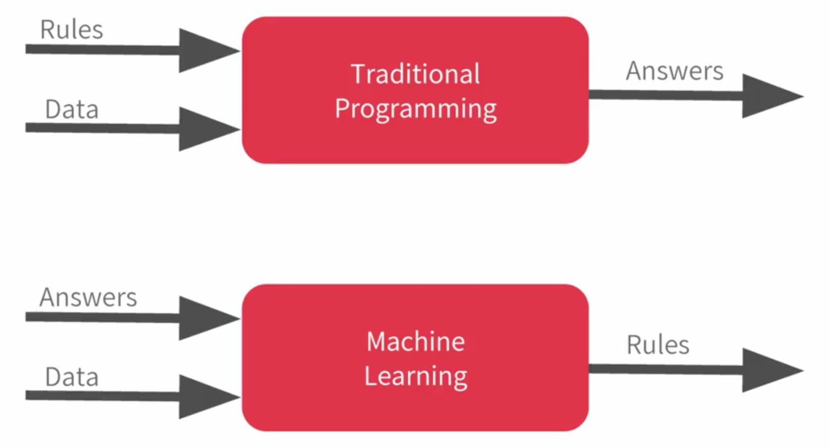
ML 101

Slide 3

Transfer learning

Slide 4
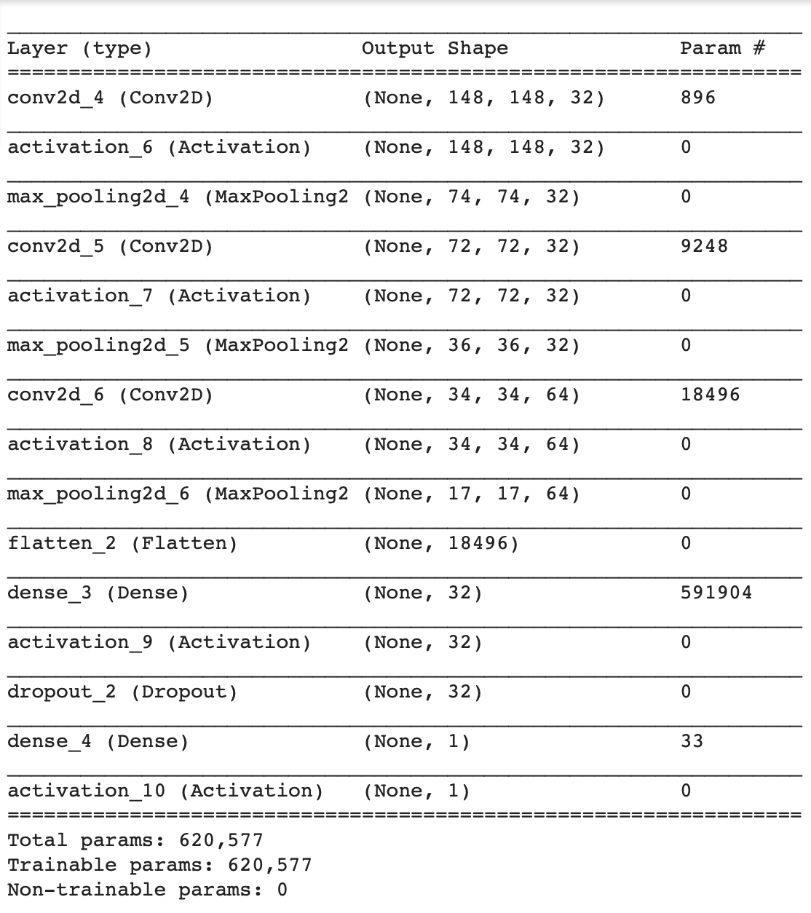
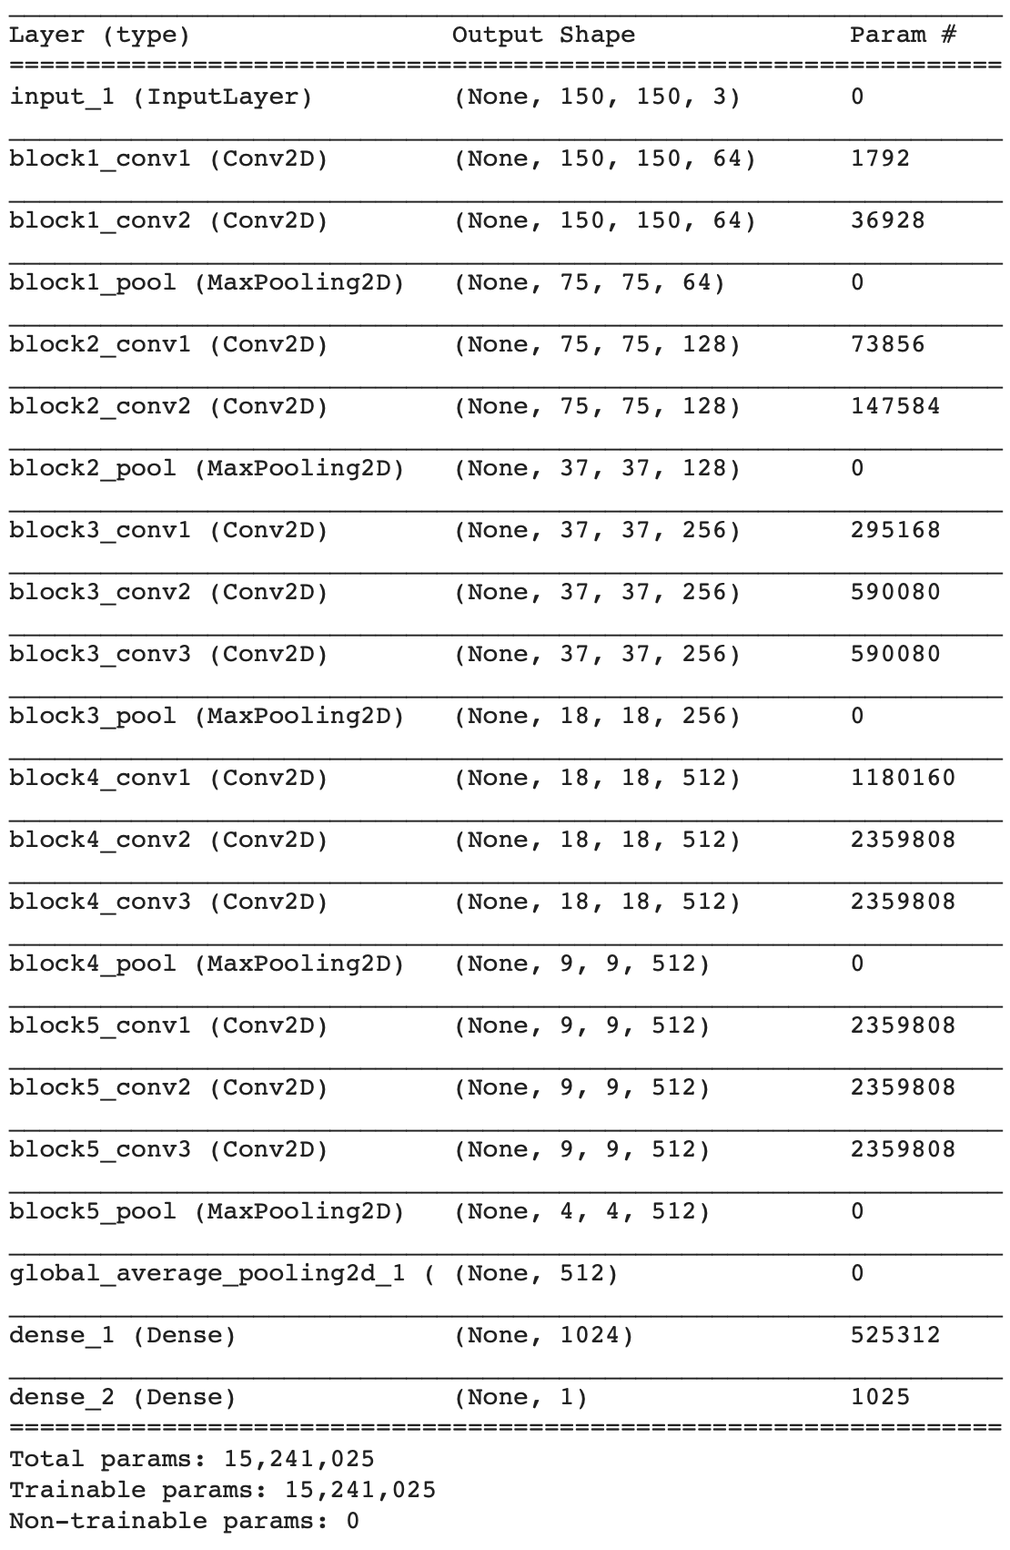
Models
Model 1: Custom
Model 2 & 3: Transfer learning

Slide 5
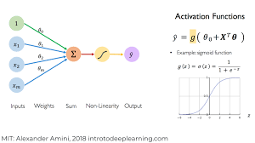
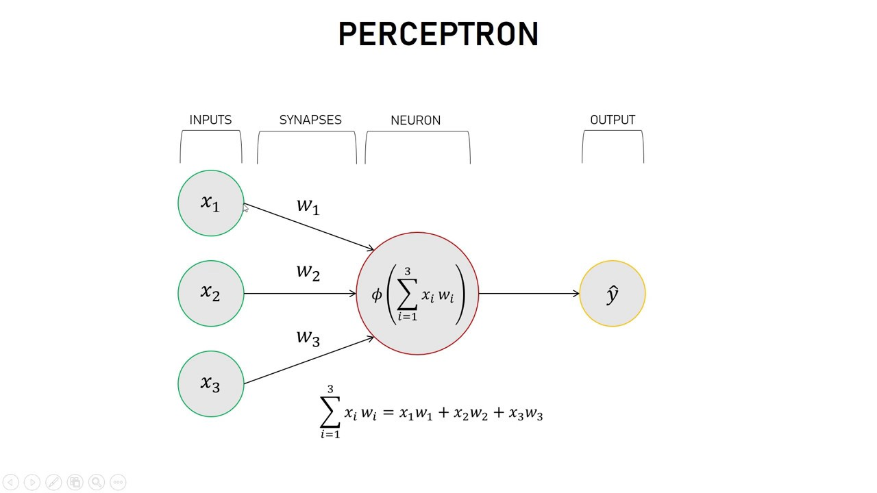
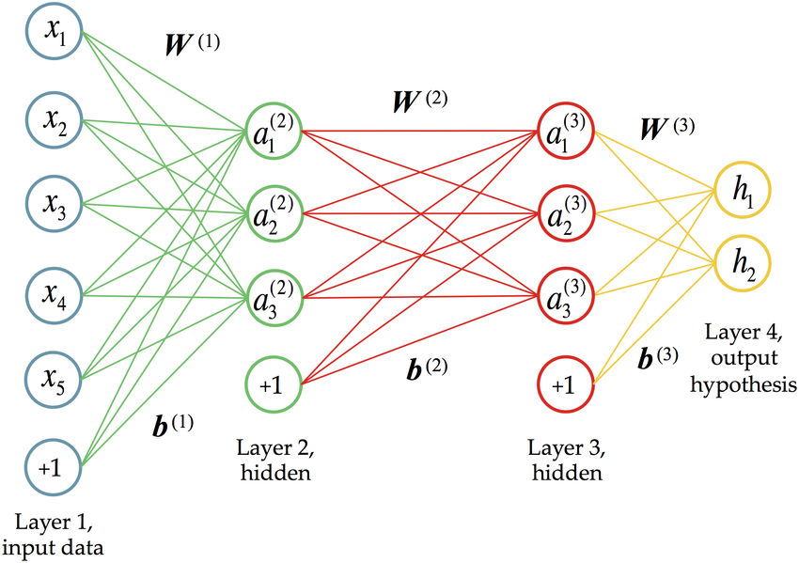
Intro to ML

Slide 6
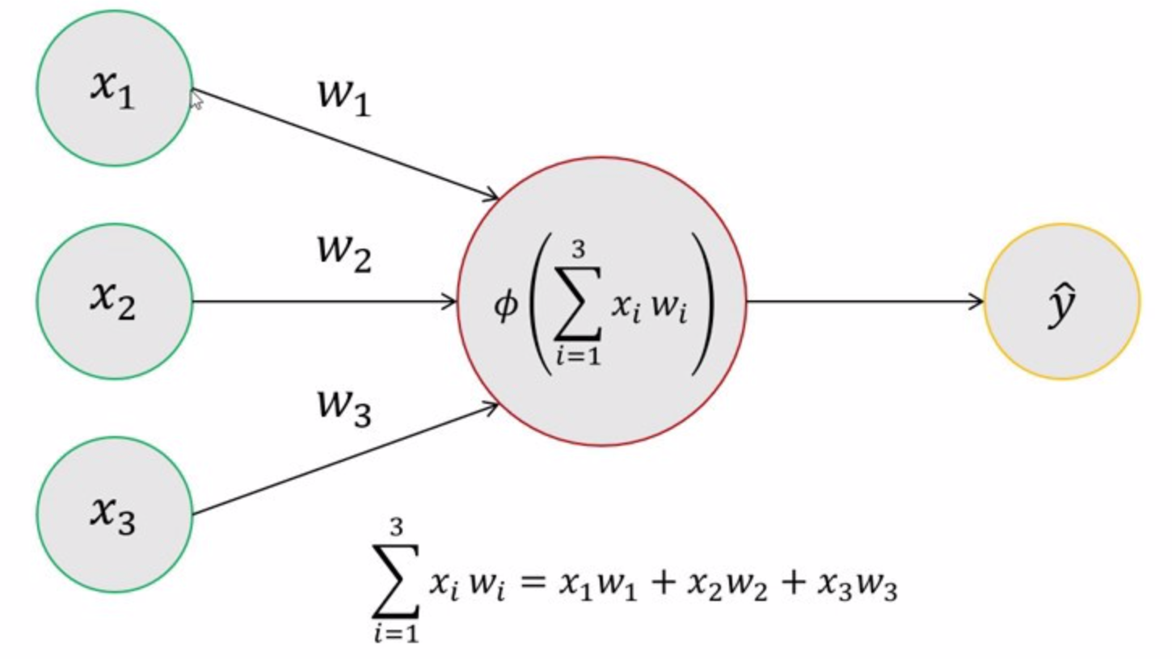
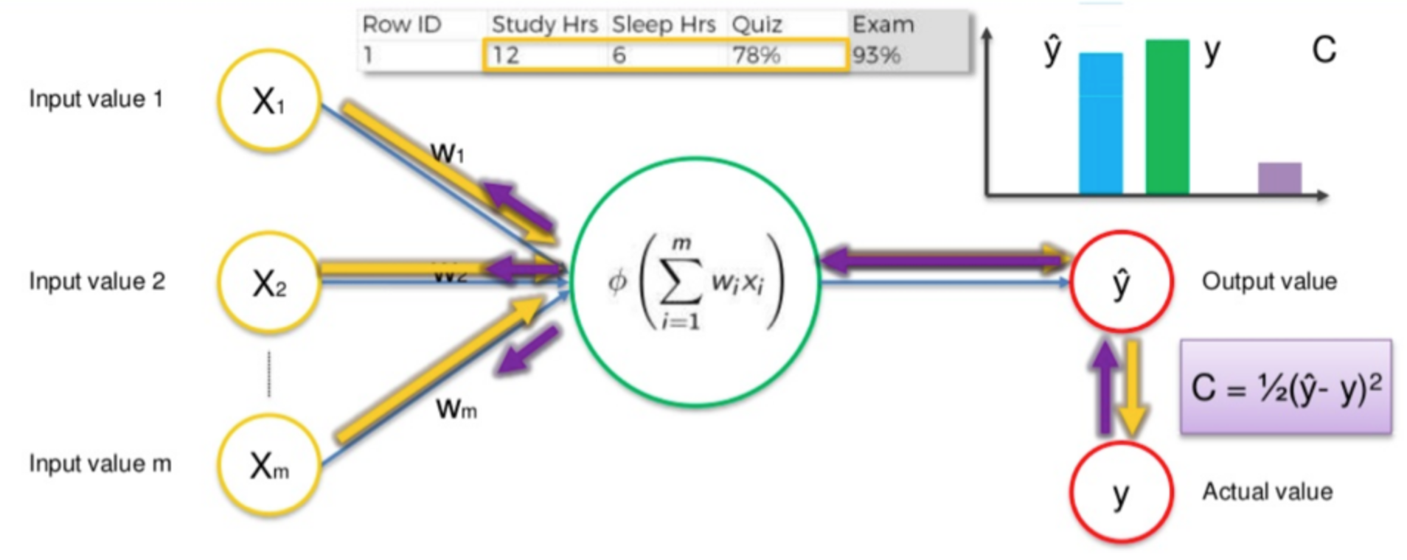
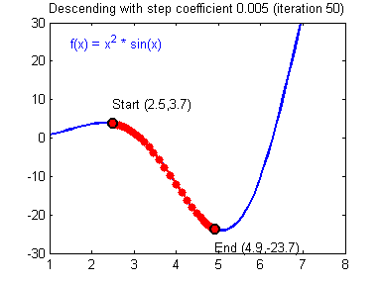
Intro to ML
Forward propagation
Backward propagation

Slide 7
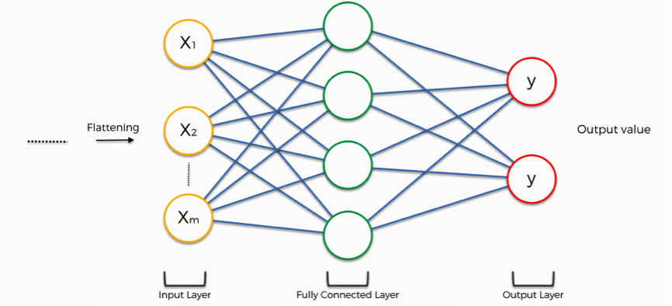
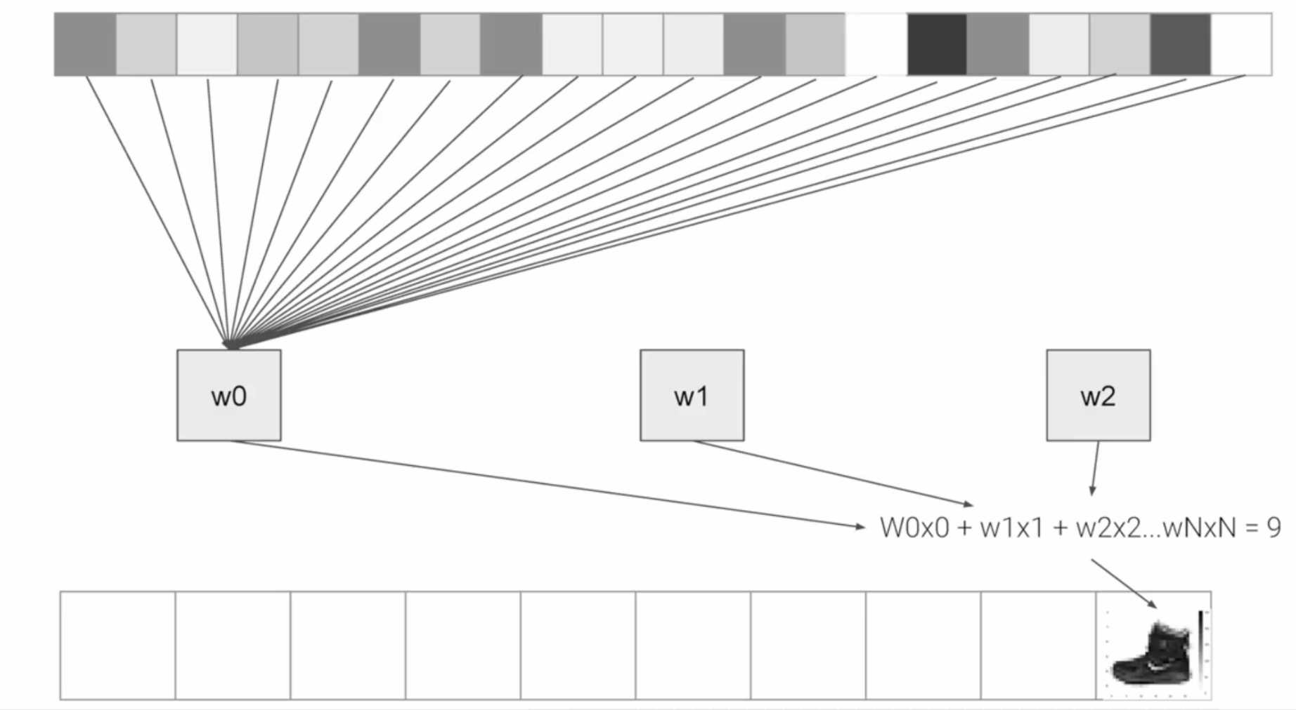

Dense layer

Slide 8
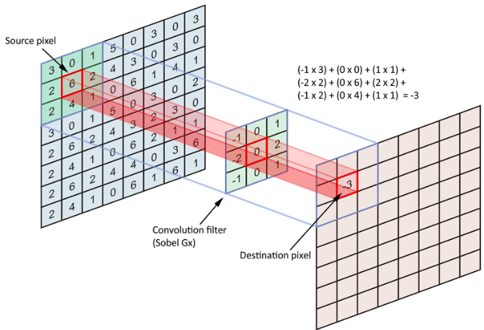
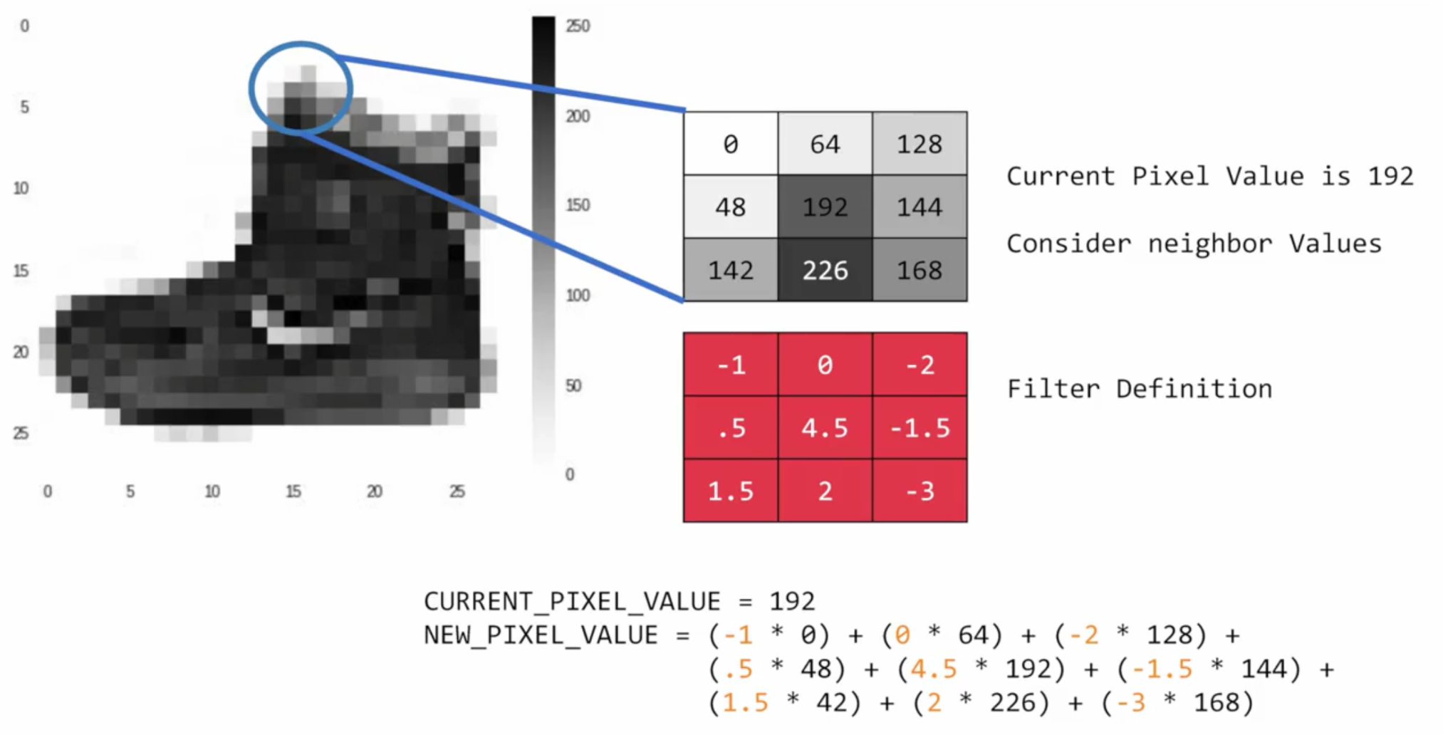
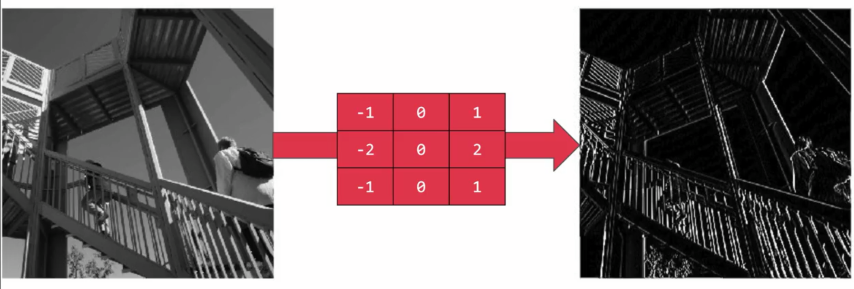
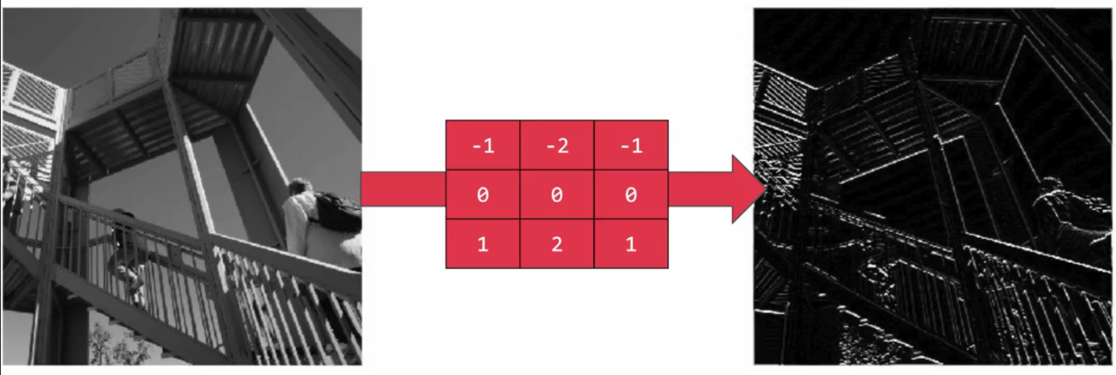
Convolutional layer

Slide 9
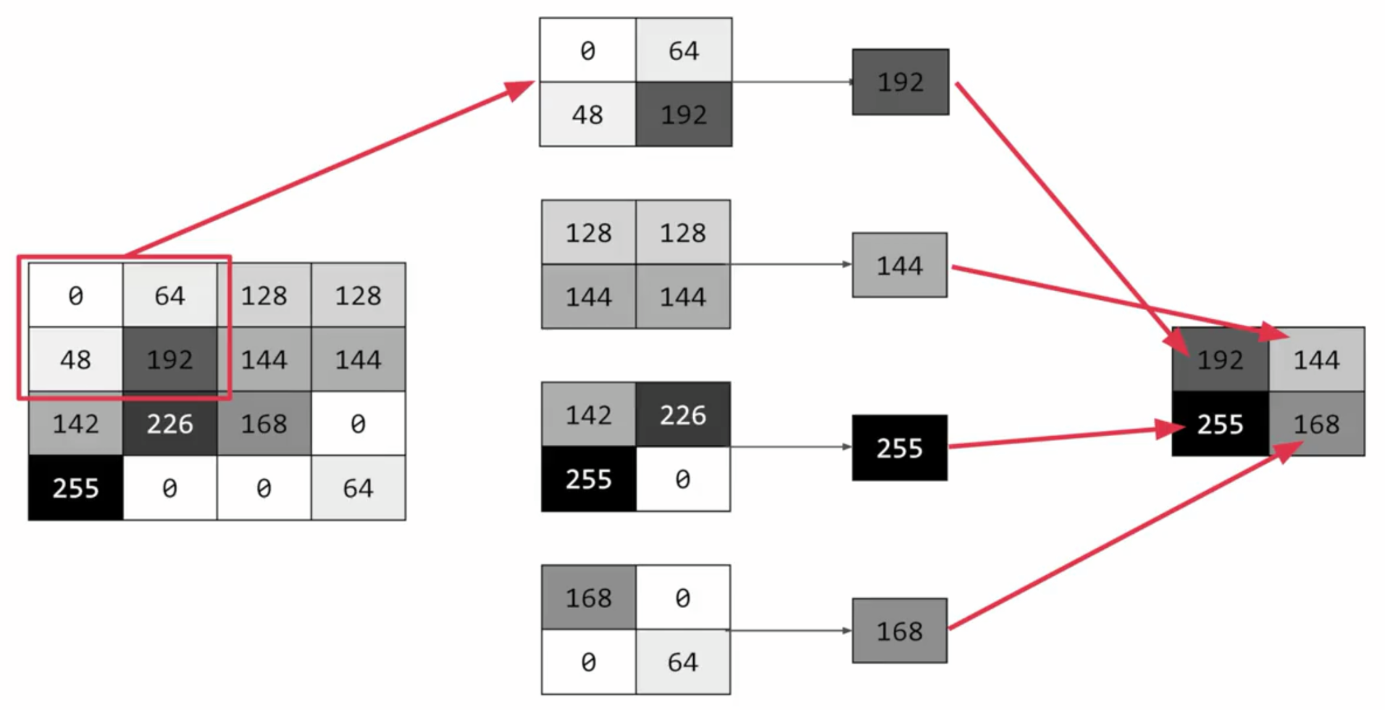
Max-pooling layer

Slide 10
Now you try it!
https://tinyurl.com/LLURadAIIG

Slide 11
ML Research Projects
Dr. Acharya:
US
MR- SI joint (Jared’s)
Xray-Metfx
Xray-UAC (Need team)
Dr. Harder/Dr. Kido:
MR-Seizures
CT-Atlantoaxial dissociation (Alex)
Dr. Tomihama
AAA
EV
Dr. Moretz
Lines and tubes
Dr. Jacobson
3 projects coming soon

Slide 12
ML Projects
Kaggle competitions
Apply for Nvidia grant
Hardware optimization
Software optimization
Prospective ML

Slide 13
3D-AR Projects
Dr. Acharya:
AR Educational models
Dr. Tomihama
AR localizations
Dr. Manalo
3D-AR for surgical planning

Slide 14
Upcoming Events
Dr. Peter Chang - September 18

